Slide 1
Chapter 12
TWO-WAY BETWEEN-GROUPS ANOVA

Slide 2
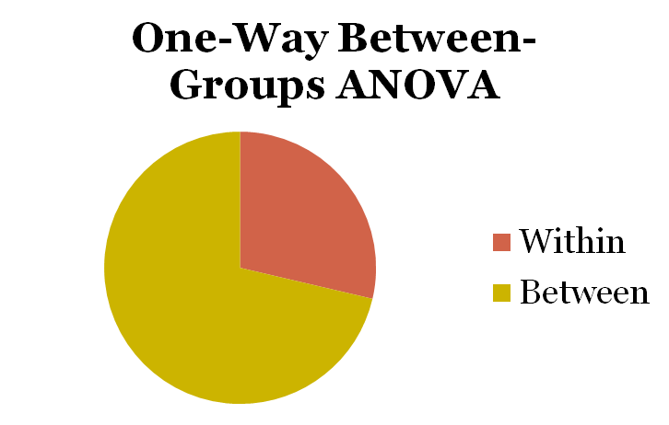
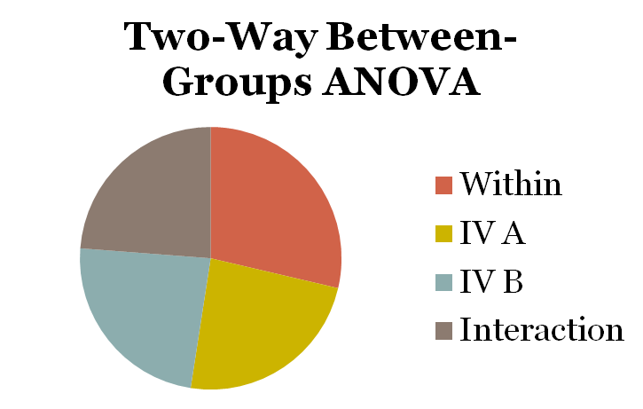
Partitioning of Variance

Slide 3
Assumptions
random selection of samples
normal distribution of DV in populations
homogeneity of variances
  samples come from populations with similar variances

Slide 4
Example
We know that women live longer than men
What about right-handed and left-handed people?
Coren & Halpern (1991) included data on both gender and handedness, as well as age at death.

Slide 5
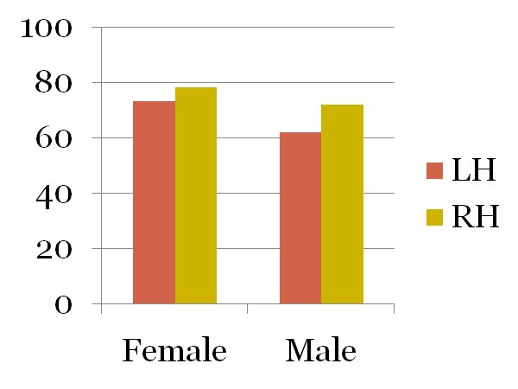
Example
Female
Male
LH
73
62
67.5
78
72
75
RH
75.5
67

Slide 6
Example
Condition | Age at Death | M
F, LH | 76, 74, 69 | 73
F, RH | 82, 78, 74 | 78
M, LH | 67, 61, 58 | 62
M, RH | 76, 72, 68 | 72

Slide 7
Step 1: Identify
Populations
  Population 1 (F; LH) = Left-handed females
  Population 2 (F; RH) = Right-handed females
  Population 3 (M; LH) = Left-handed males
  Population 4 (M; RH) = Right-handed males
Comparison distribution
  F distribution
Hypothesis test
  two-way between-groups ANOVA
Assumptions
  subjects not randomly selected
  do not know if populations are normally distributed
  we can check variances for homoscedasticity

Slide 8
Step 2: H₀ & H₁
Null Hypotheses
  H₀ : μ_{M} = μ_{F}
  H₀ : μ_{RH} = μ_{LH}
  The effect of handedness is not dependent on gender
Research Hypotheses
  H₁ : μ_{M} ≠ μ_{F}
  H₁ : μ_{RH} ≠ μ_{LH}
  The effect of handedness depends on gender

Slide 9
Step 3: Identify the Sampling Distribution
df_{rows(handedness)} = N_{rows} – 1 = 2 – 1 = 1
df_{columns(gender)} = N_{columns} – 1 = 2 – 1 = 1
df_{interaction} = (df_{rows})(df_{columns}) = (1)(1) = 1
df_{within} = df_{F,LH} + df_{F,RH} + df_{M,LH} + df_{M,RH} = 8
  df_{F,LH} = 3 – 1 = 2
  df_{F,RH} = 3 – 1 = 2
  df_{M,LH} = 3 – 1 = 2
  df_{M,RH} = 3 – 1 = 2
df_{total} = N_{total} – 1 = 12 – 1 = 11

Slide 10
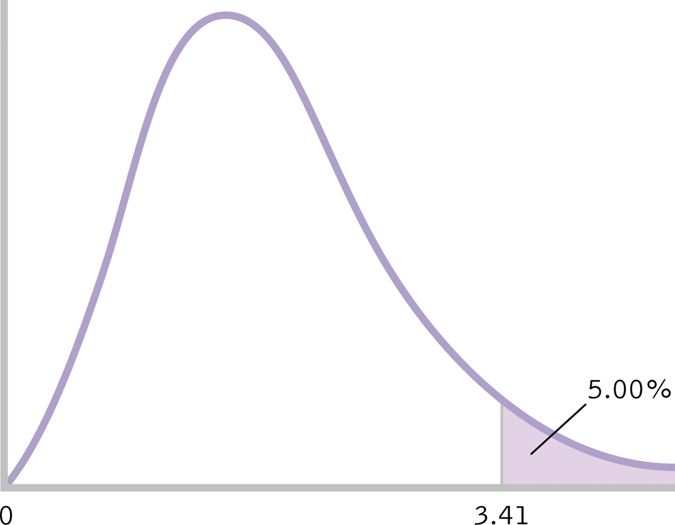
Step 4: Determine Critical Value
critical F = 5.32
5.32

Slide 11
Step 5: Calculate F
Calculate total sum of squares (SS_{total})
SS_{total} = ∑(X – GM)² = 536.22

Slide 12
Step 5: Calculate F
Calculate sum of squares for first IV (SS_{rows})
SS_{rows} = ∑(M_{row} – GM)² = 168.72

Slide 13
Step 5: Calculate F
Calculate sum of squares for second IV (SS_{columns})
SS_{columns} = ∑(M_{column} – GM)² = 216.72

Slide 14
Step 5: Calculate F
Calculate within-groups sum of squares (SS_{within})
SS_{within} = ∑(X– M_{cell})² =132

Slide 15
Step 5: Calculate F
Calculate sum of squares for interaction (SS_{interaction})
SS_{interaction} = SS_{total} – SS_{rows} – SS_{columns} – SS_{within}
SS_{interaction} = 536.22 – 168.72 – 216.72 – 132
= 18.78

Slide 16
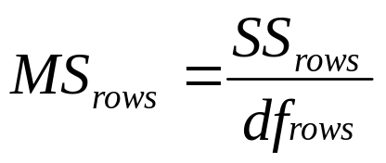
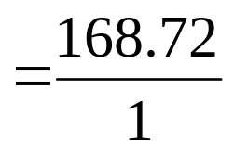

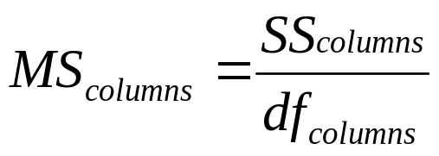
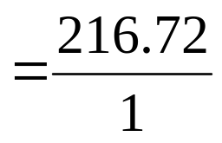

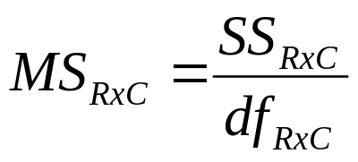
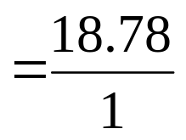

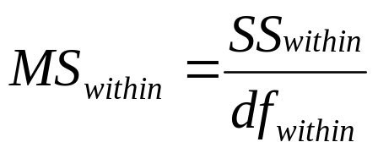
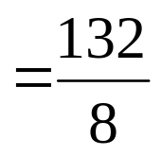

Step 5: Calculate F

Slide 17
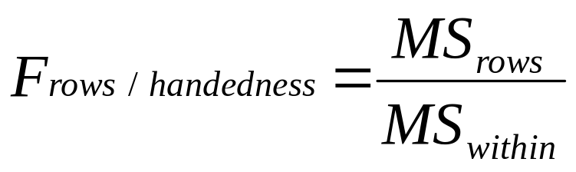
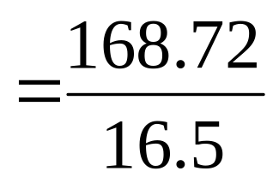
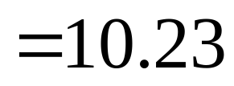
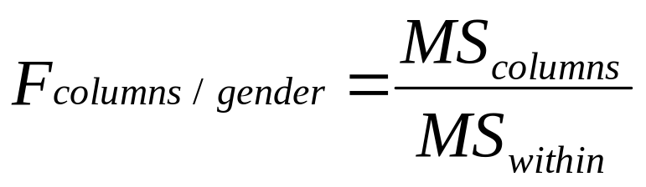
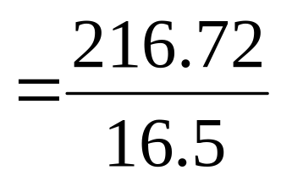
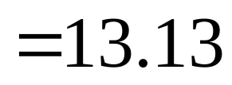
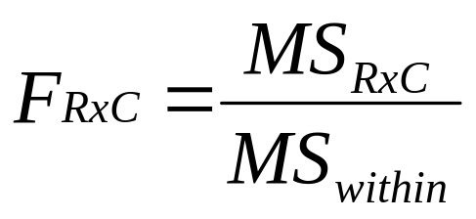
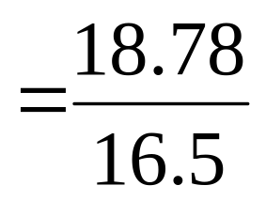
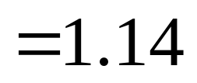
Step 5: Calculate F

Slide 18


Step 6: Make a Decision
Check to make sure we met assumption of equal variances
Is calculated F in critical region of sampling distribution?

Slide 19
Step 6: Make a Decision
*
*

Slide 20
Step 6: Make a Decision
Null Hypotheses
  H₀ : μ_{M} = μ_{F}
  H₀ : μ_{RH} = μ_{LH}
  The effect of handedness is not dependent on gender
Reject
Reject
Retain

Slide 21
Step 6: Make a Decision
Women live longer than men, F(1,8)=13.13, p<.05. Right-handed individuals live longer than left-handed individuals, F(1,8)=10.23, p<.05. There is no interaction between gender and handedness, F(1,8)=1.14, p>.05.

Slide 22
Source Table
Source | SS | df | MS | F
Handedness | 168.72 | 1 | 168.72 | 10.23
Gender | 216.72 | 1 | 216.72 | 13.13
H x G | 18.78 | 1 | 18.78 | 1.14
Within-groups | 132 | 8 | 16.5
Total | 536.22 | 11

Slide 23
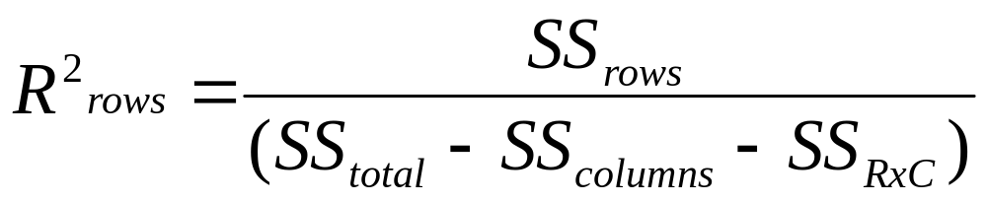
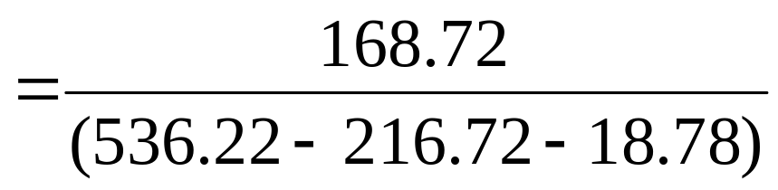

Effect Size
; large

Slide 24
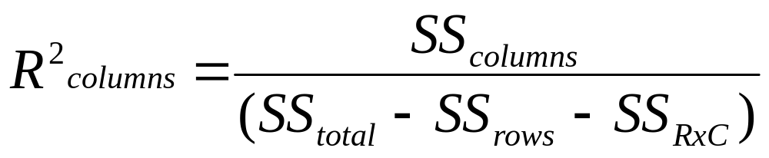
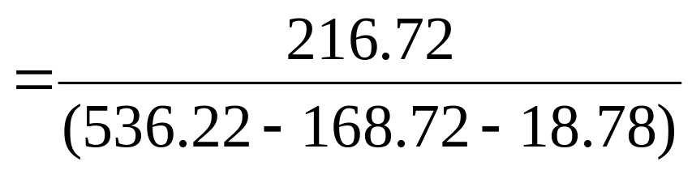

Effect Size
; large

Slide 25
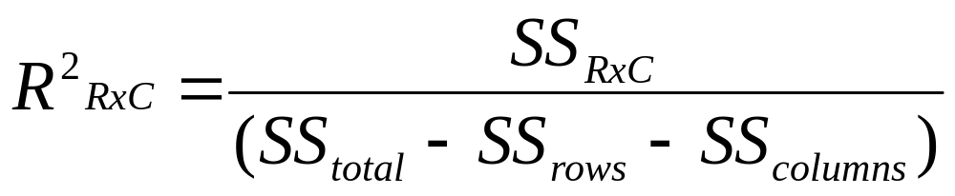
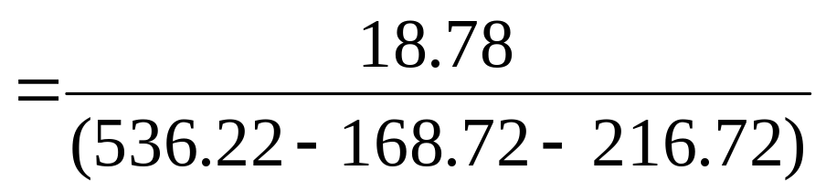

Effect Size
; medium

